Slide 1
CORE Physical Therapy
Tools for Success

Slide 2
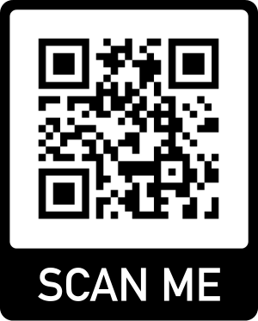
Stretch Strap
Uses for this item:
Stretch tight muscles in a safe manner, improve mobility of your joints
Instructions for use:
Your physical therapist will instruct you on the best way to use the Stretch Strap to address your specific issues
For more information
Standard - $20

Slide 3
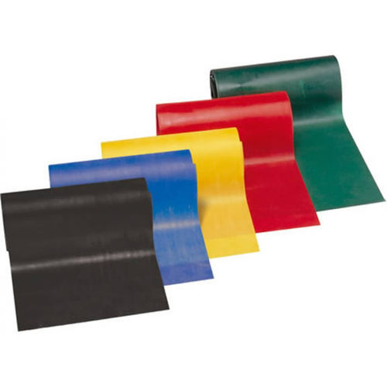
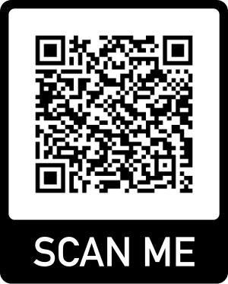
TheraBand
Uses for this item:
Global strengthening of the body; this is heavily used in all home exercise programs
Instructions for use:
Your physical therapist will instruct you on the best way to use the TheraBand to address your specific issues
For more information
$6 each or 3 for $15

Slide 4
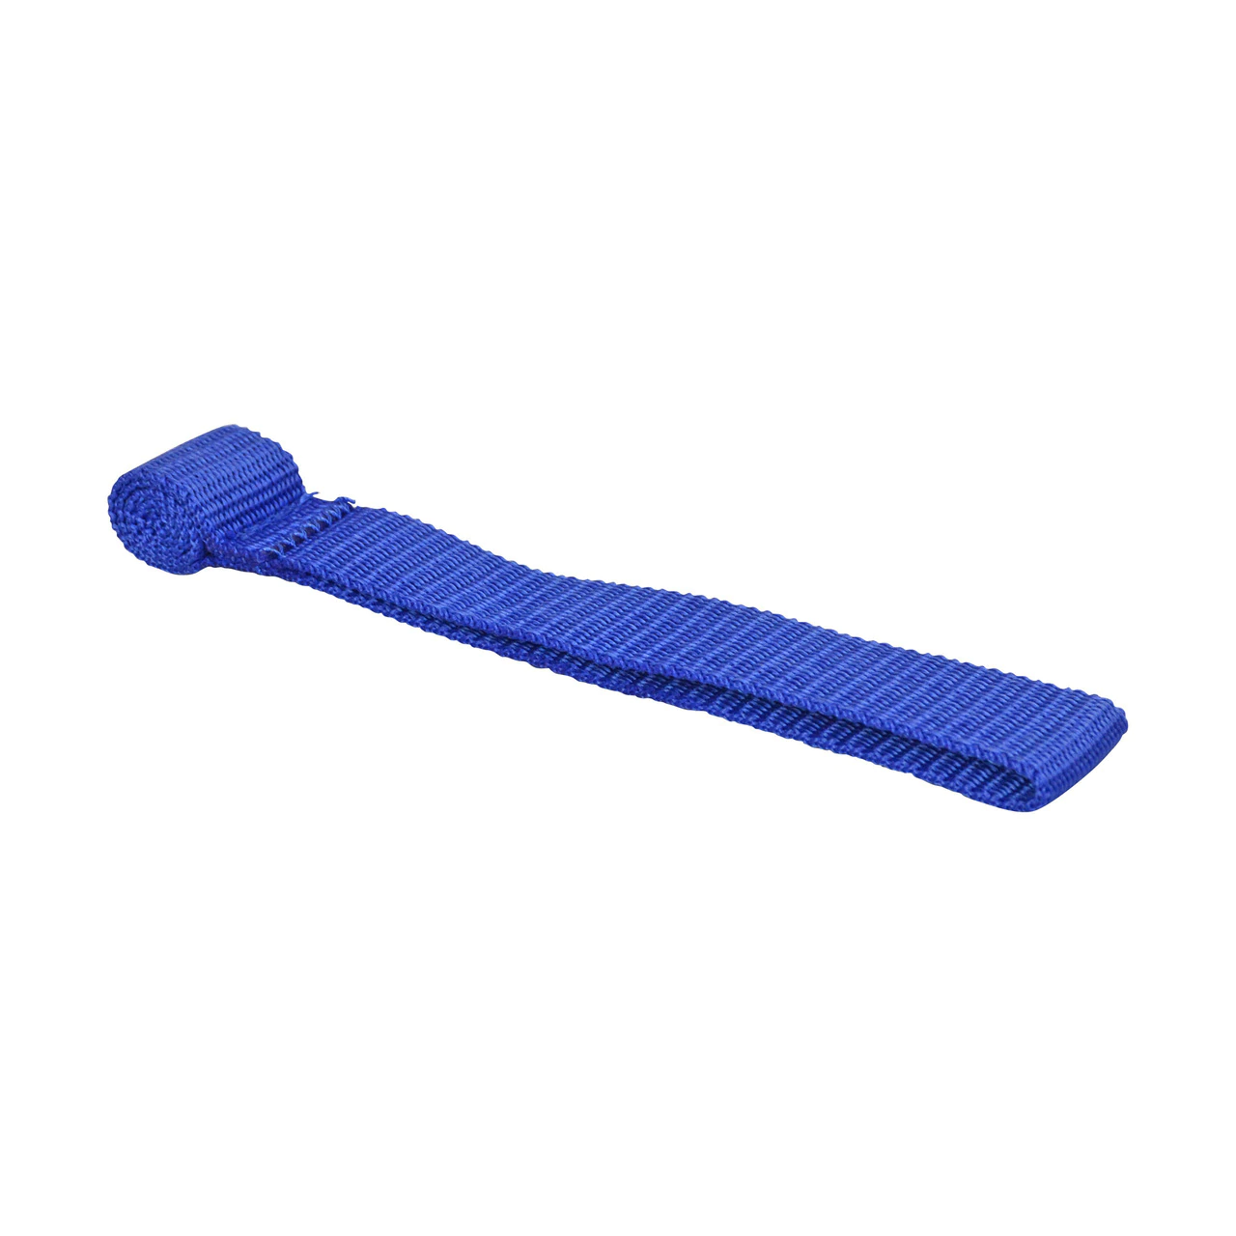
TheraLoop
Uses for this item:
This Item is paired with the TheraBand to allow the band to be stabilized in a door frame.
Instructions for use:
Place the thickened area of the TheraLoop in the door frame and close the door. Thread the Theraband through the loop and perform exercise as instructed.
Standard - $2

Slide 5
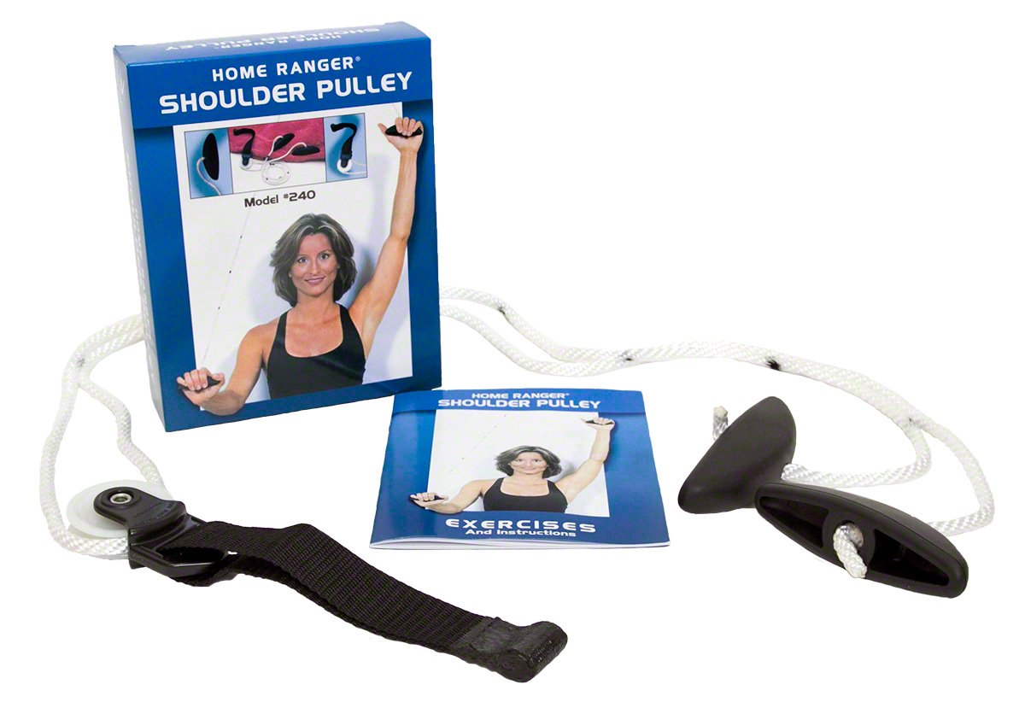
Shoulder Pulley
Uses for this item:
Increasing shoulder mobility in a gentle way for those with shoulder injury or surgery
Instructions for use:
Insert black strap into door ledge.
Close door to secure black strap.
Hold grips and assist shoulder into desired direction as prescribed by the therapist.
Standard - $15

Slide 6
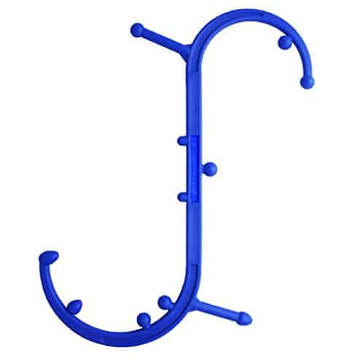
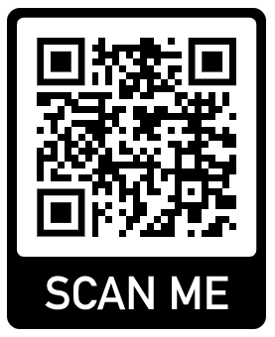
Back Buddy
Uses for this item:
Relax muscles that are difficult to get to such as behind the neck, mid back, and low back.
Instructions for use:
Orient bulbs to trigger point(s).
Apply pressure until tight areas are resolves.
For more information
Standard - $32

Slide 7
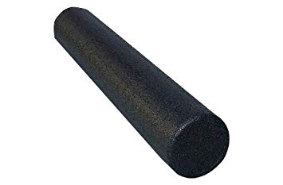
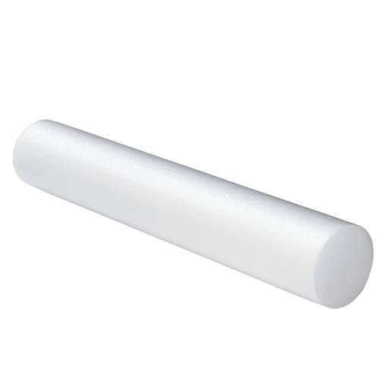
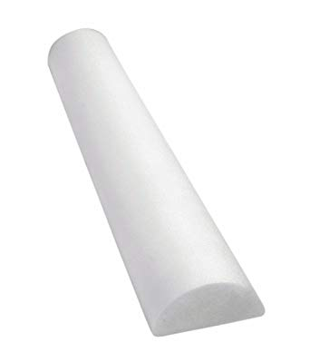
Foam Rollers
Uses for this item:
Stretching, reducing muscle tension, improving spinal mobility, decreasing pain and many more!
Instructions for use:
Your physical therapist will instruct you on the best way to use the foam roller to address your specific issues
High density (black) - $28 Low density (white) - $26
Low density (half) - $14

Slide 8
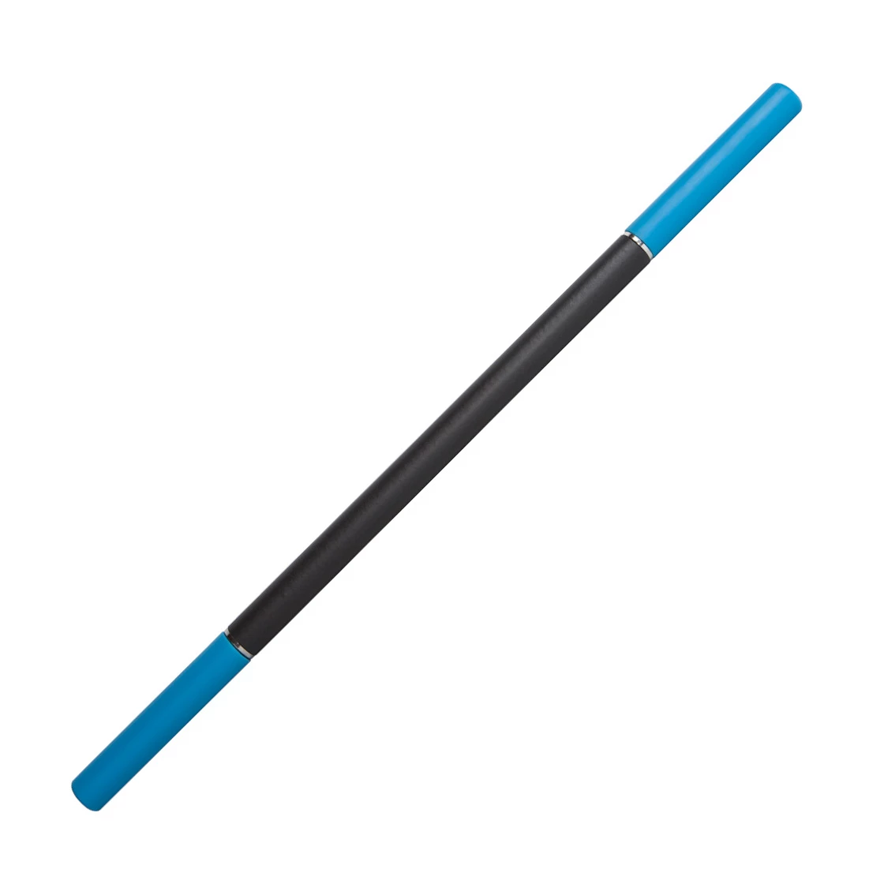
Rad Rod “Stick”
Indications for item:
Reduce tension and tightness in large muscles (thigh, calf, buttock, IT Band, etc…)
Instructions for use:
Grip stick on blue handles.
Apply force in a pinrolling fashion onto tender areas until pain dissipates.
Standard - $40

Slide 9
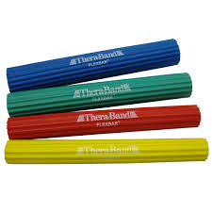
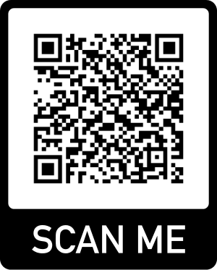
Flex Bar
Uses for this item:
Increase wrist, hand and general upper extremity strength and mobility
Instructions for use:
Your physical therapist will instruct you on the best way to use the Flex Bar to address your specific issues
For more information
All Colors - $28

Slide 10
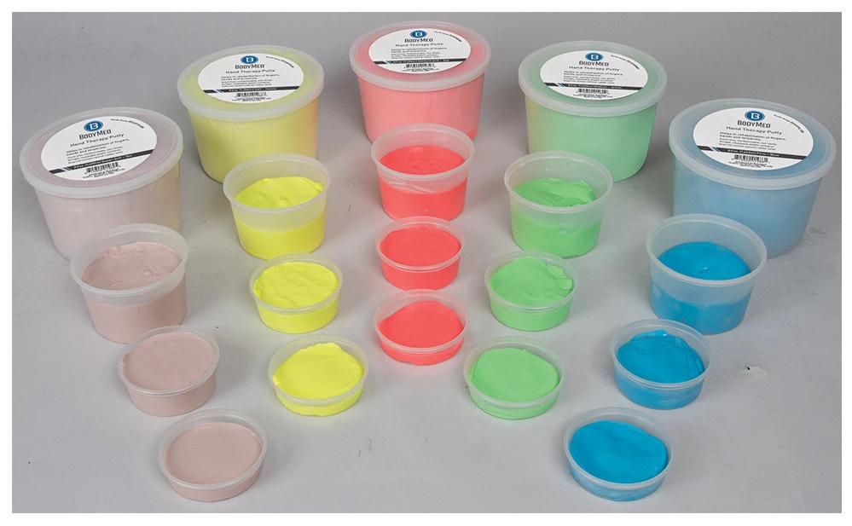
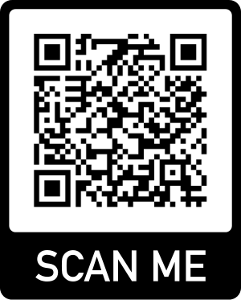
Therapy Putty
Uses for this item:
Improve strength and dexterity of the hand and fingers
Instructions for use:
Your physical therapist will instruct you on the best way to use the Therapy Putty to address your specific issues
For more information
Standard (all colors) - $7

Slide 11
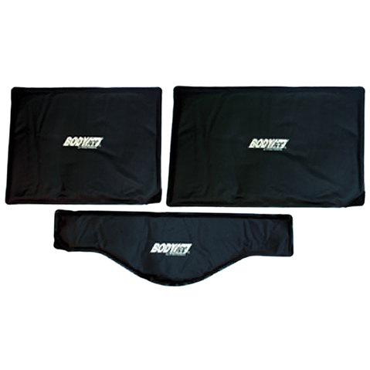
BODYice (cold pack)
Instructions for use:
Put in freezer for 1-2 hours.
Apply cold packs to painful area.
Application should not exceed 20 minutes.
Uses for this item:
Relieve pain
Reduce inflammation
Neck - $22 Standard - $22 Oversized - $32
*barrier must be placed between ice pack and skin to prevent burns

Slide 12
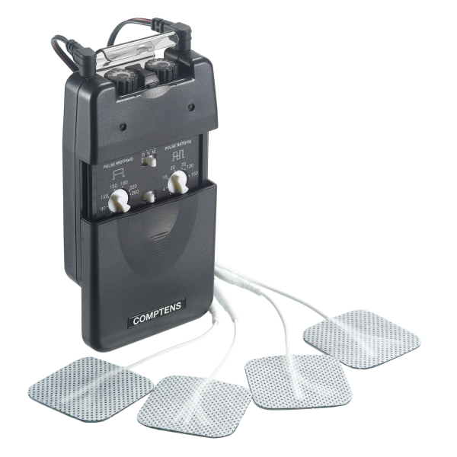
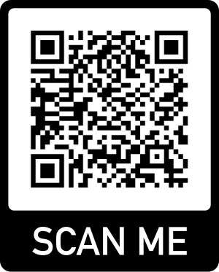
TENS Unit
Uses for this item:
Safe and non pharmaceutical way to relieve pain
Instructions for use:
Attach an electrode to both the black and red wires.
Place electrodes onto skin surrounding painful area.
Your physical therapist will demonstrate to you the proper settings for your needs
For more information
Standard Unit - $40 Electrodes - $5

Slide 13
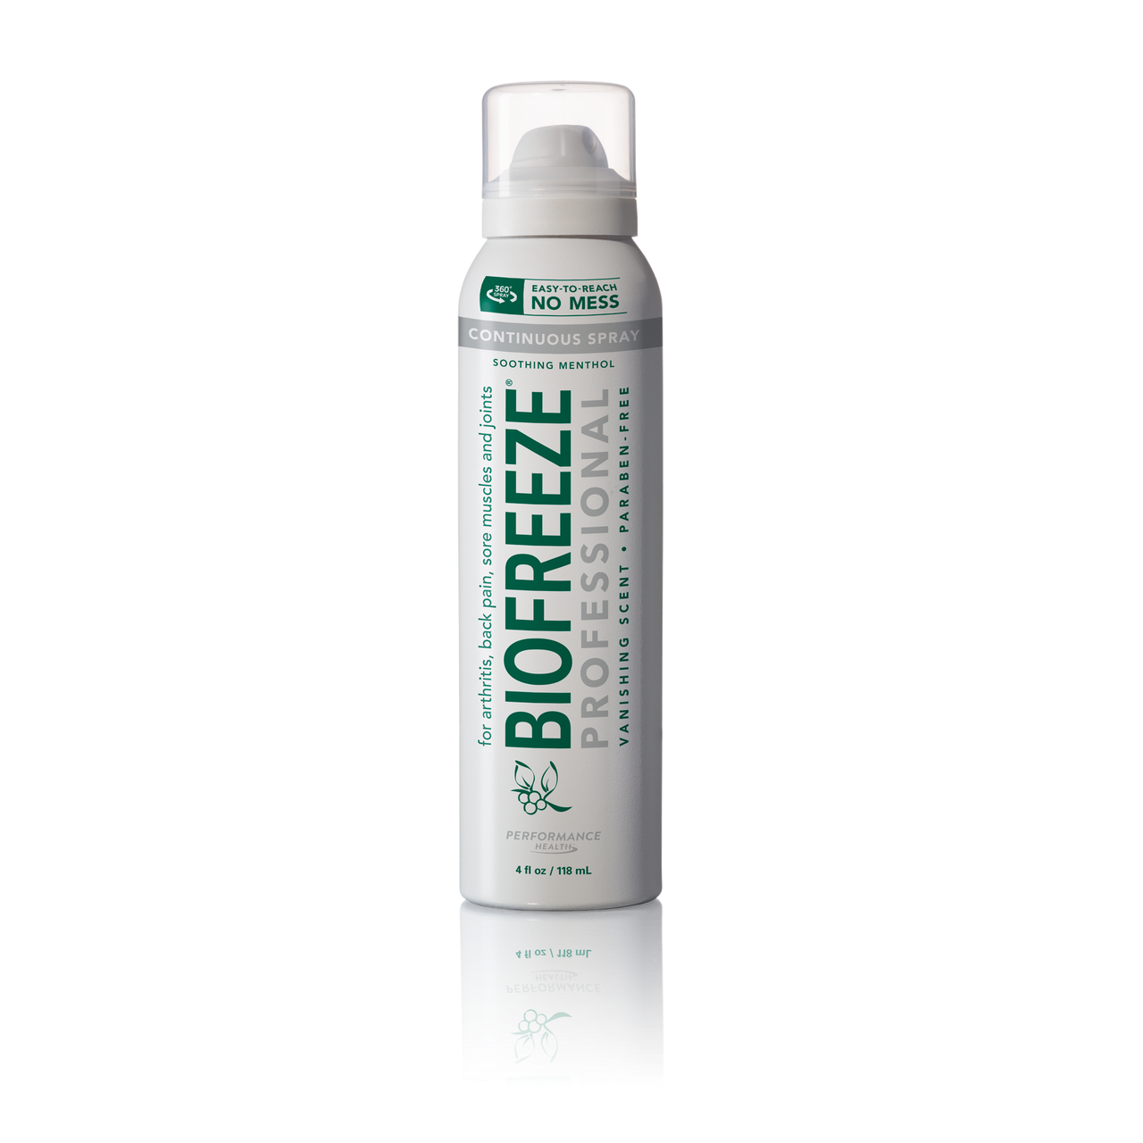
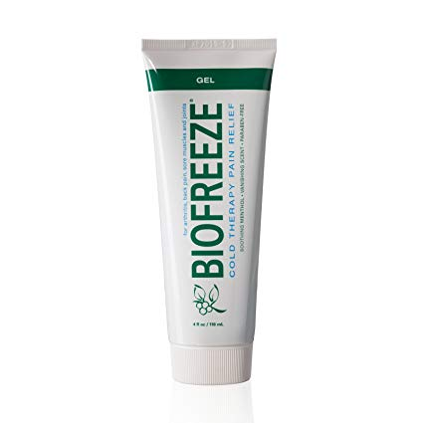
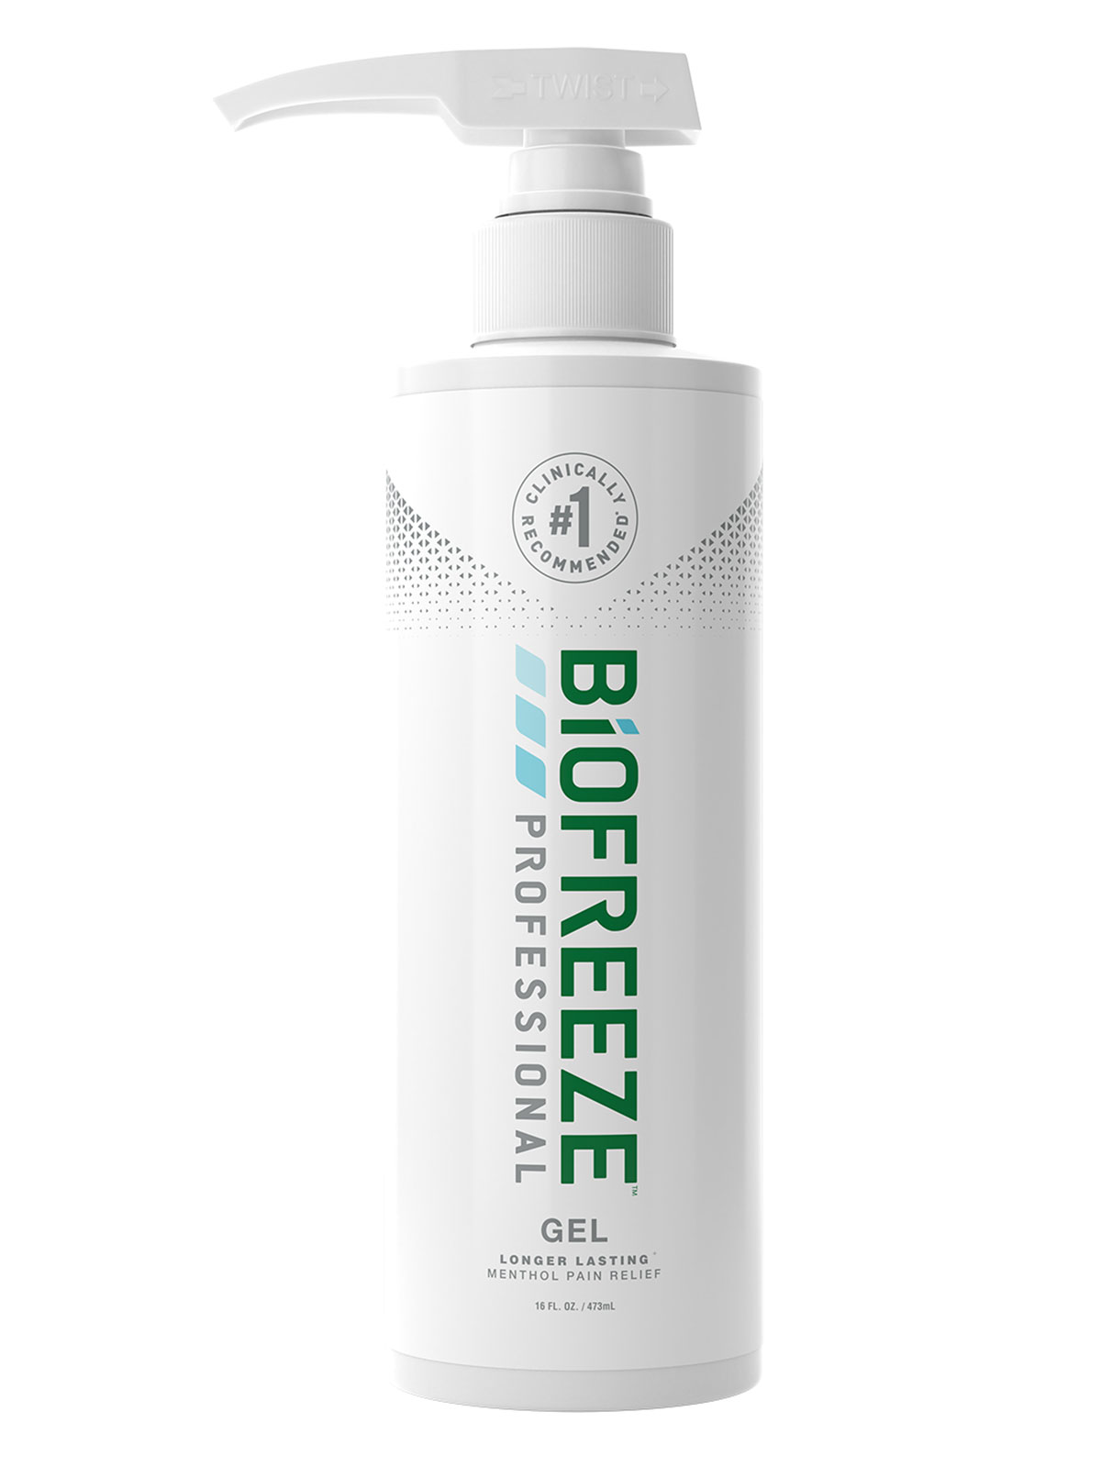
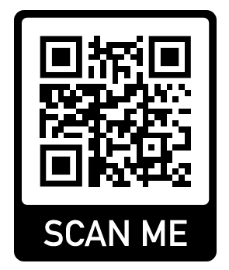
Biofreeze
Uses for this item:
Cooling cream for pain relief
Instructions for use:
Apply a thin film of Biofreeze to painful area.
For more information
Pump - $50 Spray/Tube - $12

Slide 14
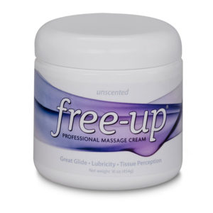
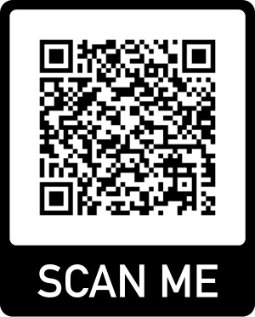
Free Up (professional massage cream)
Uses for this item:
Reduce friction of the skin for a better massage
Instructions for use:
Apply a pea sized drop of cream onto skin.
Massage drop into a thin film over skin.
Reapply if necessary.
For more information
Standard - $32

Slide 15
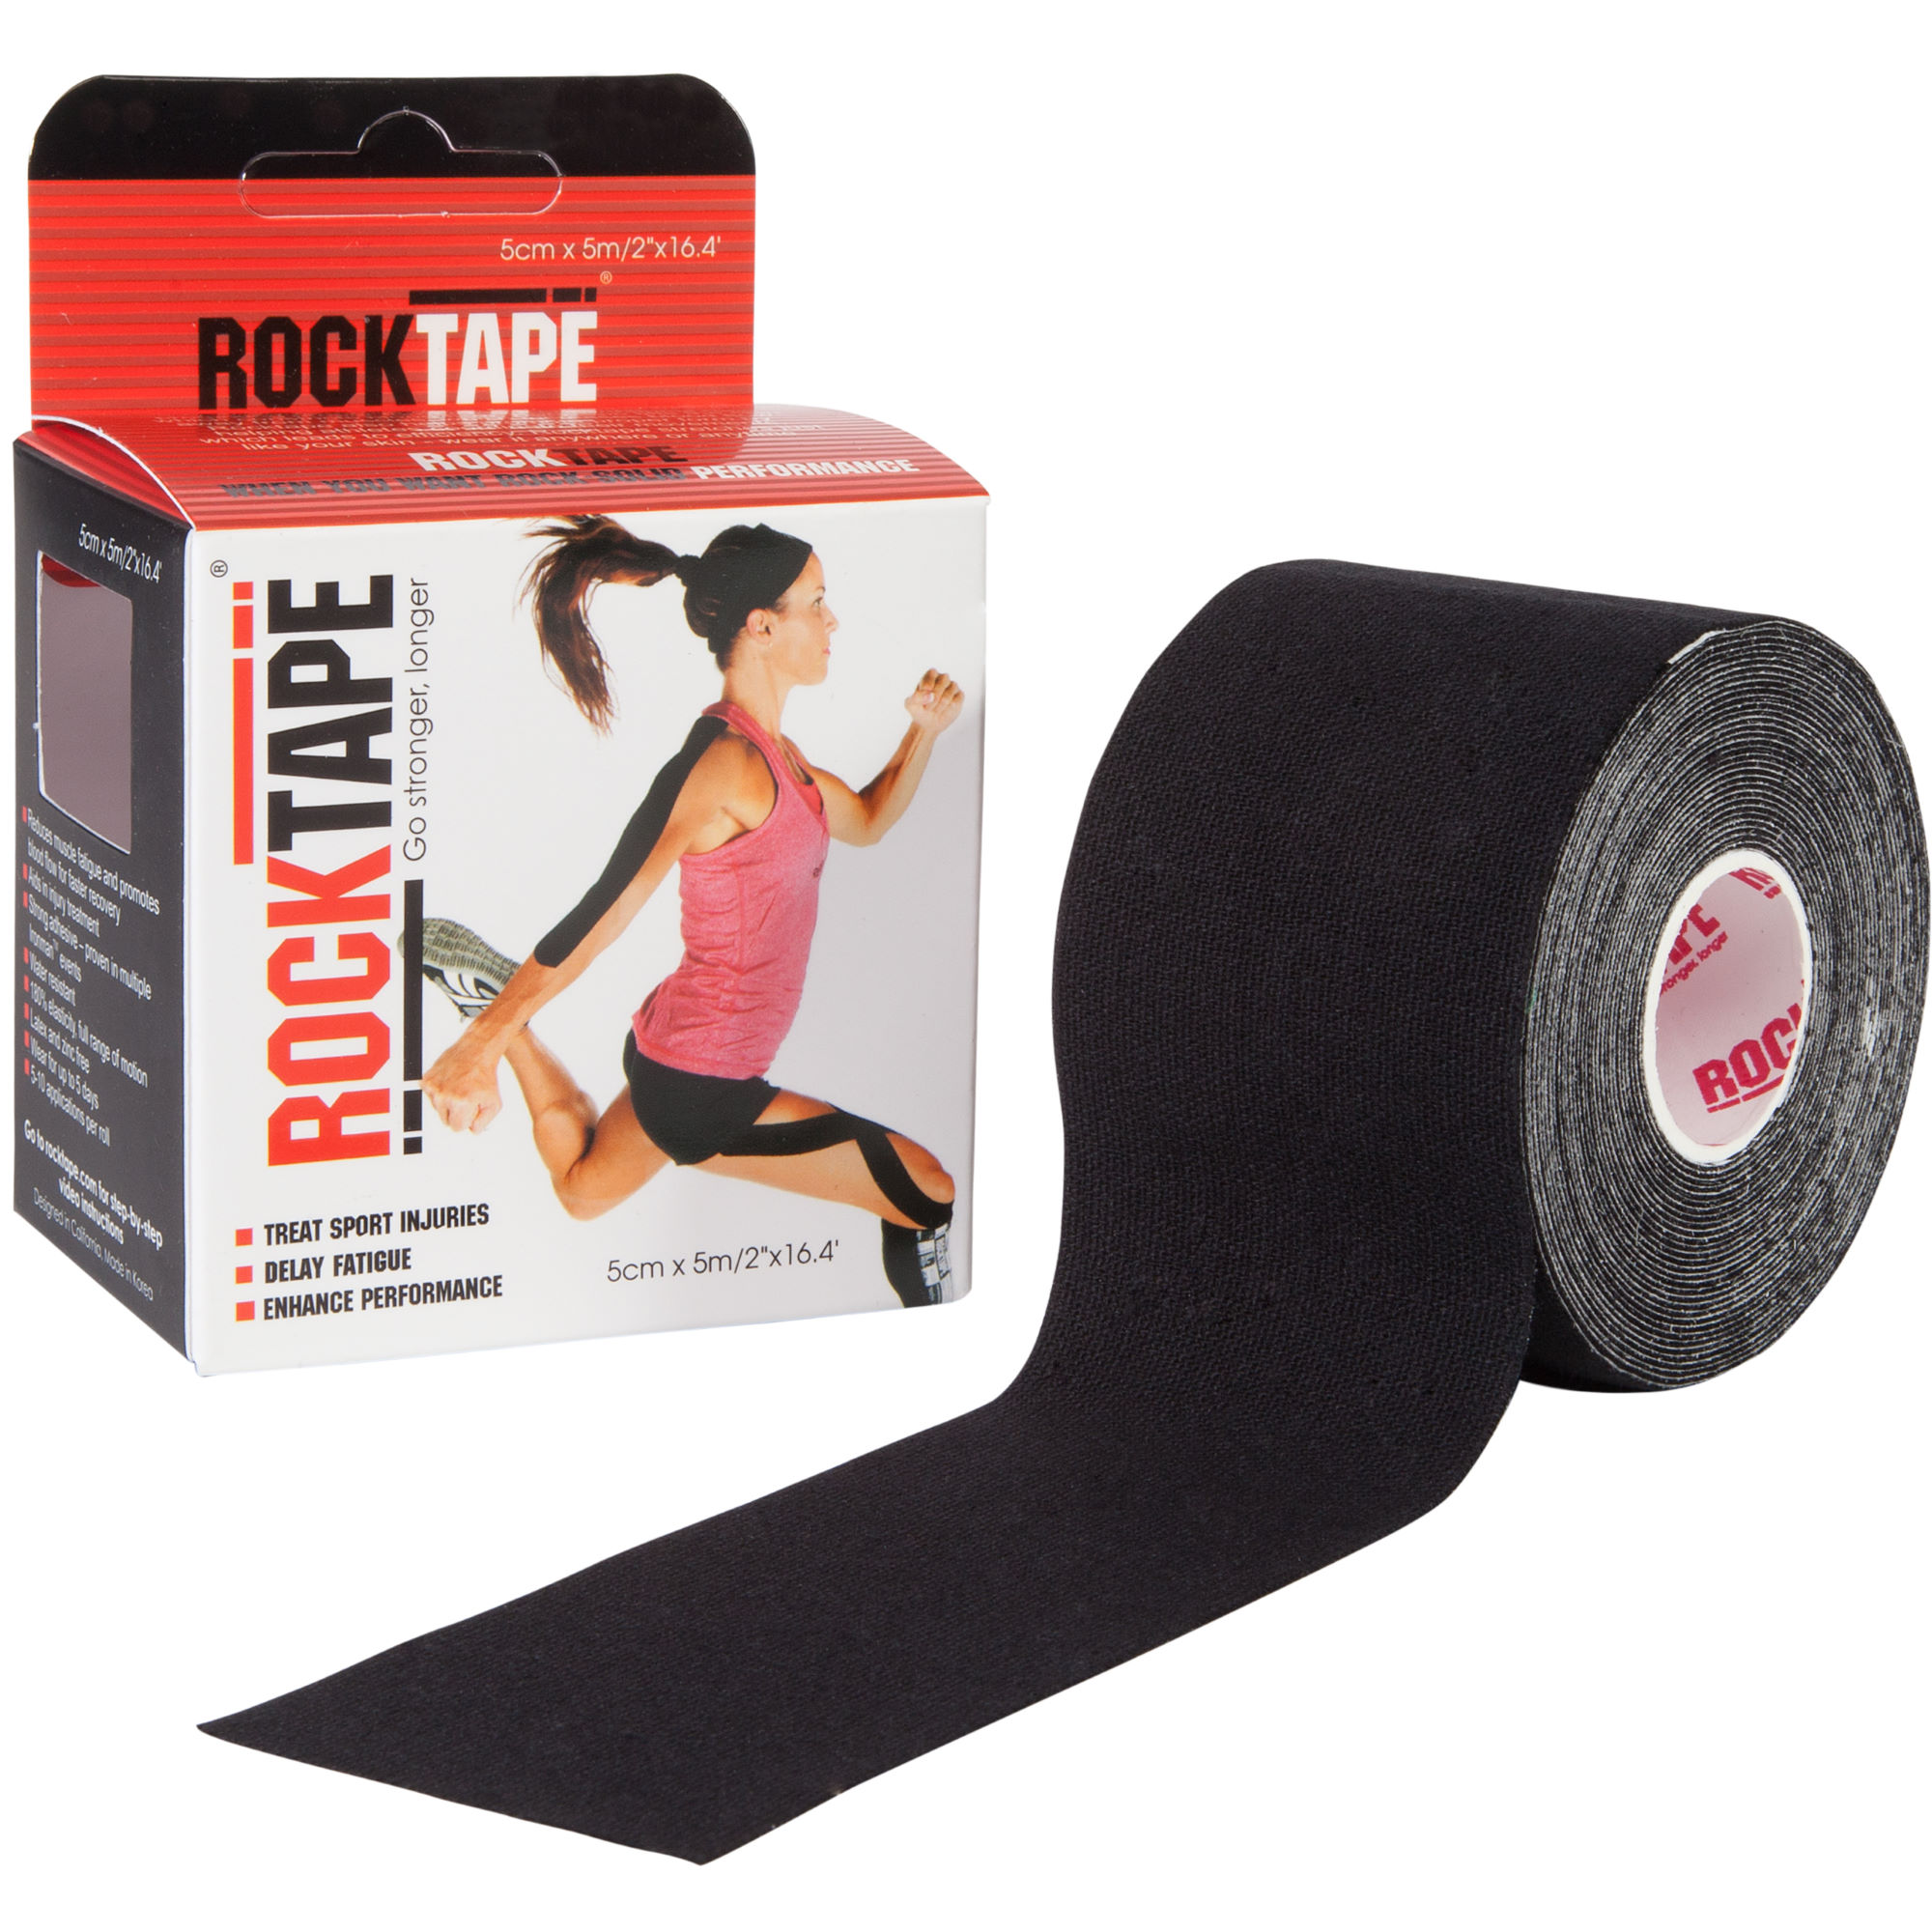
Rock Tape
Uses for this item:
Stretching tape used to correct posture, stabilize joints, reduce friction, decrease pain
Instructions for use:
Your physical therapist will instruct you on the best way to use the Kinesio Tape to address your specific issues
For more information
Standard Box - $20
*Tape should not be left on for more than 5 days; Do not blow dry tape

Slide 16
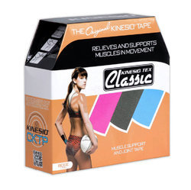
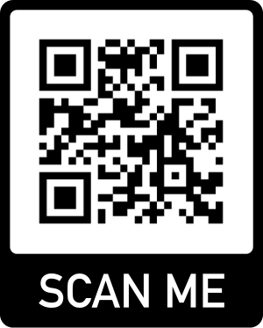
Kinesio Tape (KT tape)
Uses for this item:
Stretching tape to correct posture, stabilize joints, reduce friction, decrease pain
Instructions for use:
Your physical therapist will instruct you on the best way to use the Kinesio Tape to address your specific issues
For more information
Standard Box - $15
*Tape should not be left on for more than 2 days; Do not blow dry tape

Slide 17
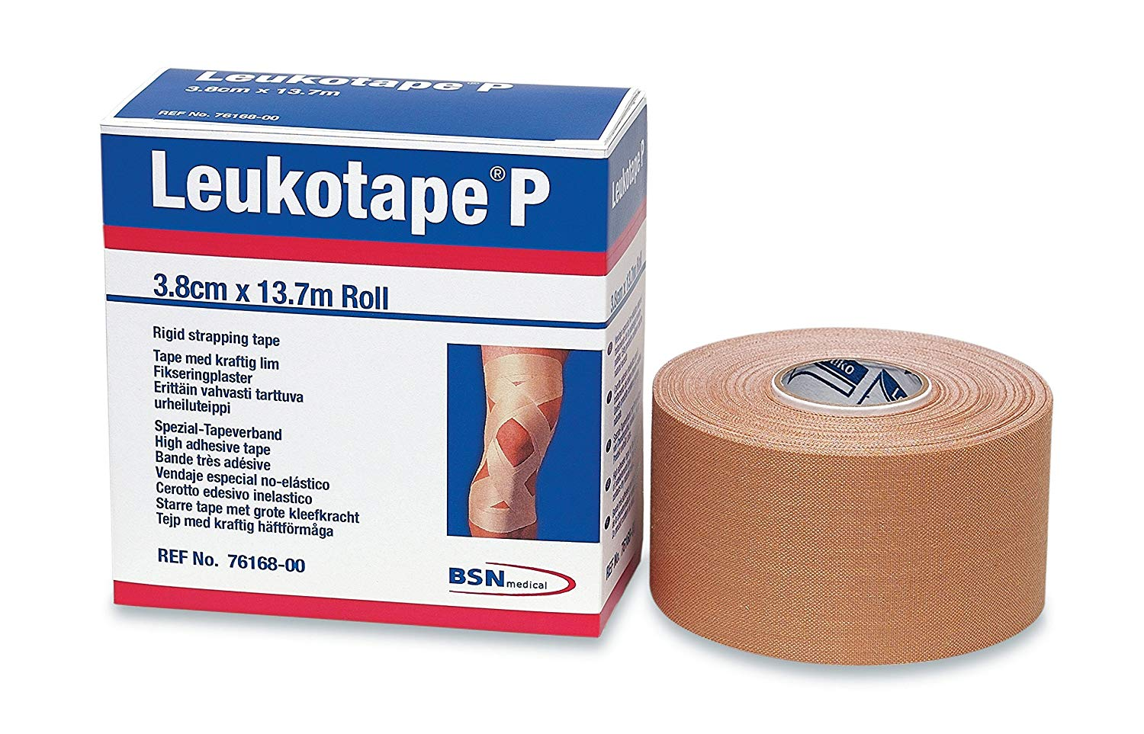
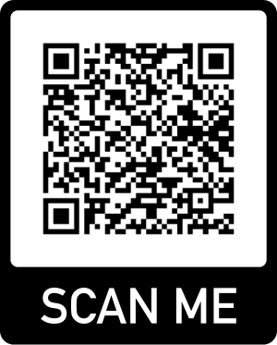
Leukotape
Uses for this item:
Used to add strong stability to a joint or reduce friction on the skin such as from shoes
Instructions for use:
Your physical therapist will instruct you on the best way to use Leukotape to address your specific issues
For more information
Standard Box - $15

Slide 18
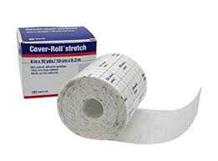
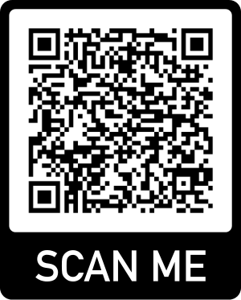
Cover-Roll stretch
Uses for this item:
Attaching light items to the body such as TENS unit pads, wires, etc.
Instructions for use:
Cut out appropriately sized length of tape.
Apply to secure item onto skin.
For more information
Standard Roll - $30

Slide 19
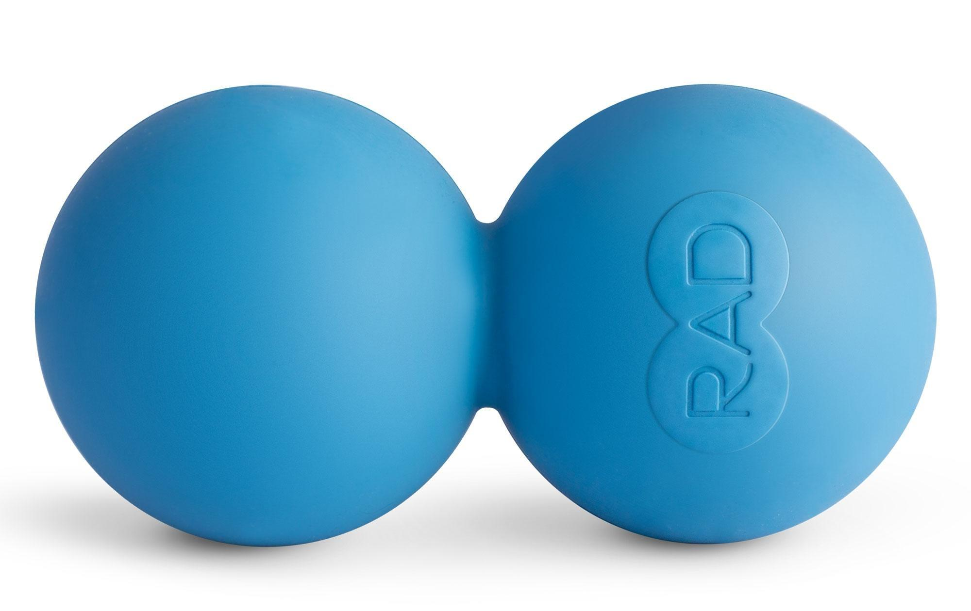
Peanut
Uses for this item:
Decrease intensity and Frequeny of headaches, reduce tension in the neck musculature
Instructions for use:
Stabilize ball onto stable surface.
Apply force onto tender areas until pain dissipates.
Standard - $25

Slide 20
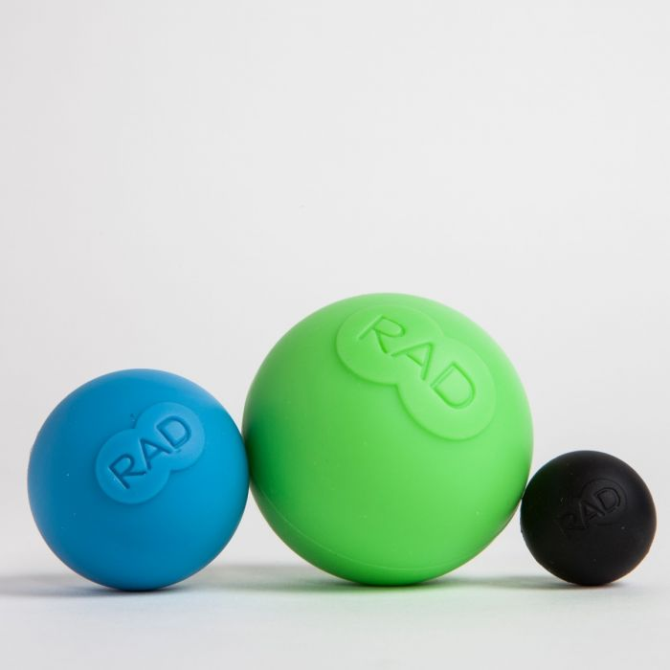
Rad Balls
Uses for this item:
The three different sized balls allow you to target the many different areas of the body such as feet, hands, shoulders and back.
Instructions for use:
Stabilize ball onto stable surface.
Apply force onto tight or tender area until pain dissipates.
Standard Box (three balls) - $16

Slide 21
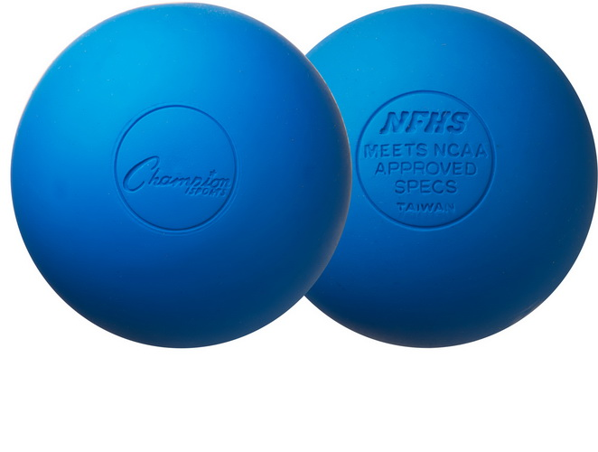
Lacrosse Ball
Uses for this item:
Targets tension in large muscles (thigh, back, buttock, shoulders, chest, etc…)
Instructions for use:
Stabilize ball onto stable surface.
Apply force onto trigger point until tightness and pain dissipates.
Standard Ball - $3

Slide 22
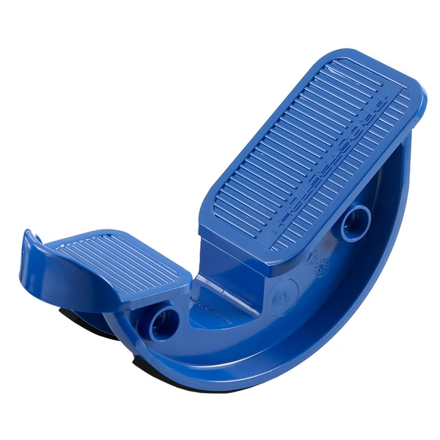
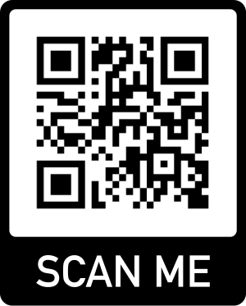
Pro Stretch
Uses for this item:
Stretching tight calf muscles especially when you are unable to bear all of your weight through the lower extremity, balance training
Instructions for use:
Place Pro stretch on a stable flat surface.
Pull up toes and hold for 30 seconds for calf stretch.
For more information
Standard - $30

Slide 23
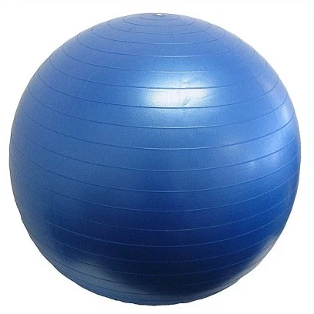
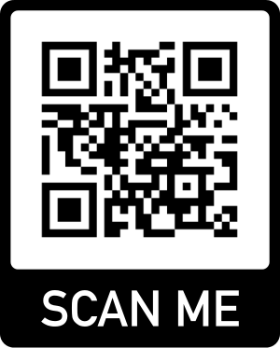
Swiss Ball
Uses for this item:
Safe and efficient way to strengthen the core and back; The swiss ball can also be used as a chair to ensure proper posture in sitting
Instructions for use:
Your physical therapist will instruct you on the best way to use the Swiss Ball to address your specific issues
For more information
All Sizes/Colors - $20

Slide 24
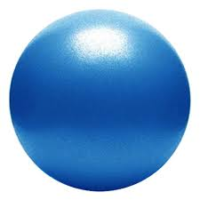
Pilates Ball
Uses for this Item:
Strengthening for the core, upper and lower extremities such as given in your home exercise program
Instructions for use:
Your physical therapist will instruct you on the best way to use the Pilates Ball to address your specific issues
Standard Ball - $10 Instructional DVD - $10

Slide 25
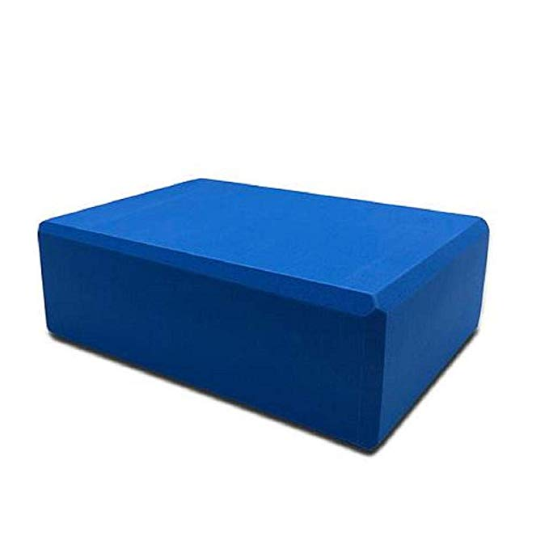
Yoga block
Uses for this item:
Safely training balance training, stretching
Instructions for use:
Place block on solid and stable surface.
Perform balance and stretching activities as prescribed by therapist.
Standard - $10

